Slide 1
Digital Marketing (Unit – 2)
by
Dr. Sunil Pratap Singh (Assistant Professor, BVICAM, New Delhi) May 2022
Notes:
1

Slide 2
Display Advertising
Display advertising refers to the act of communicating the advertising message using visually rich media.
The main objective of display advertising is to build brand image.
The first step in building brand image is to create awareness.
Display advertising is very powerful in creating awareness as it is a push medium, and hence can be shown on websites with huge traffic to reach maximum users.
The mode of communication may be through traditional media (newspaper, pamphlets, television, etc.) or digital media (websites, social media, etc.)

Slide 3
Display Advertising Media
The main objective of display advertising is awareness and brand building and .
For awareness, the most important requirement is ‘Reach’.
The metrics for measuring the reach are different for different mediums of display advertisement.
Display Advertising Media
Print Media
Television
Digital

Slide 4
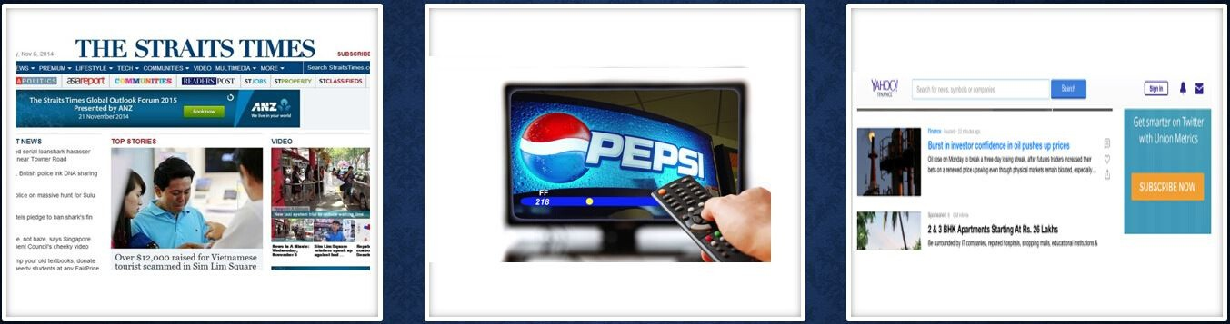
Display Advertising Media
PRINT MEDIA
The most traditional mode of communication.
TELEVISION
Video contents have better engagement rates.
DIGITAL
Includes ads served via mobile and website.
Metric: Circulation / No. of readers
Metric: No. of viewers
Metric: No. of unique users and page views

Slide 5
Display Advertising Media (contd…)
Print Media
It is the most traditional mode of communication.
The metric for measuring the reach in print media is circulation or no. of readers.
Television (TV)
Television advertising has video content and has better engagement rates then the print media.
The metric for measuring the reach in TV is the number of viewers.
Digital
Display advertisements include ads served via website and mobile.
The metric for measuring the reach in digital is unique users and page views.

Slide 6
Digital Metrics
Ad Impressions
An ad impression is recorded whenever an ad is displayed on the user’s screen through website.
It is simply the number of times an ad is displayed.
Example: If we visit a website and an ad loads, it is considered one ad impression for the website. Suppose, four ads of different companies are shown then this leads to four ad impressions for the publisher’s website and one ad impression for each advertiser.
Display ads are run on many digital media platforms such as Facebook, LinkedIn, Twitter and Search Engines.

Slide 7
Digital Metrics (contd…)
Clicks - A click is counted whenever a user clicks on an ad. Upon clicking, it redirects the user to the landing page.
Click Through Rate (CTR)
CTR = (Total No. of Clicks / Total No. of Impressions) * 100
CTR is an important metric in deciding the effectiveness of an ad.
Low CTR indicates that the most of the users are ignoring the ad after seeing it. In such cases, three factors are to be checked and corrected:
Category of Product or Service – Product categories such as mobile phones tend to have higher CTR as compared to categories such as grocery, cosmetics, B2B products/services, etc.
Creativity
Placement

Slide 8
Types of Display Ads
Display ads can be classified into different types based on two factors, namely format and size.
Display Ad Format
Based on format, display ads can be grouped into three categories:
Image Ads – contains static images related to product or service
Rich Media Ads – includes interactive media such as animation or other dynamic aspects which change upon user interaction
Video Ads – embeds video in the ad. This format of advertising is extensively used in YouTube. It is highly effective and is gaining immense popularity in the advertising world.

Slide 9
Types of Display Ads (contd…)
Display Ad Size
Display ads are put up in various sizes based on the availability of space on the websites.
The most popular, top performing and standardized ads size are:
Medium Rectangle
Large Rectangle
Leaderboard
Half Page
Large Mobile Banner
Large Format Ads
Skinning/Takeover

Slide 10
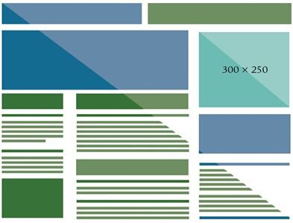
Medium Rectangle Ad
The medium rectangle ad is the most popular display ad.
The ad size is 300 (width) × 250 (height) pixels.
The contents could include text, images or other animations.
It is available in desktop and mobile platform.

Slide 11
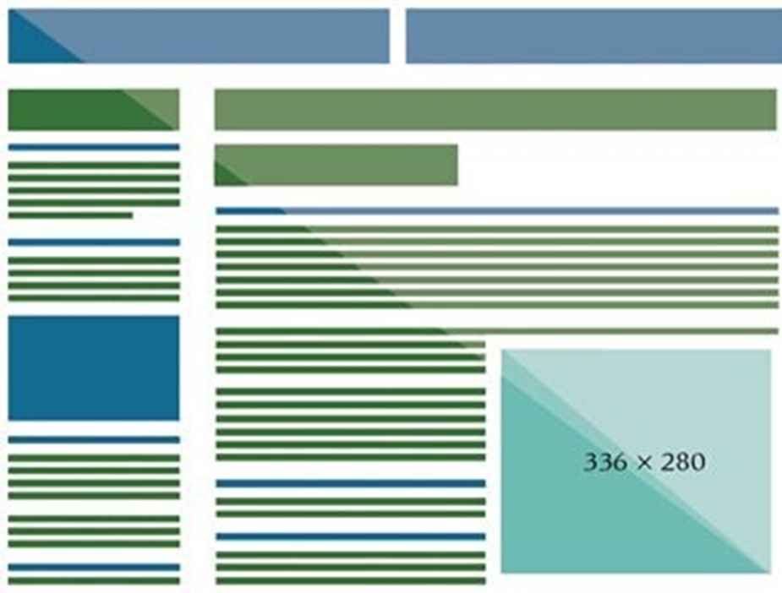
Large Rectangle Ad
Large rectangle has more ad space as compared with medium rectangle ad, and thus can be used to communicate better.
The ad size is 336 (width) × 280 (height) pixels.
It is available only in desktop mode.

Slide 12
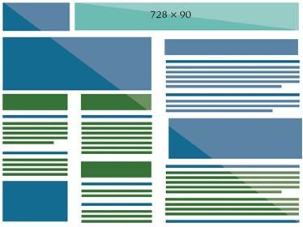
Leaderboard Ad
This ad is generally placed above the main content (at the top of the page).
The standard size for this ad is 728 (width) × 90 (height) pixels.
It is available only in desktop mode.
It is generally found in portals, news sites, forums.

Slide 13
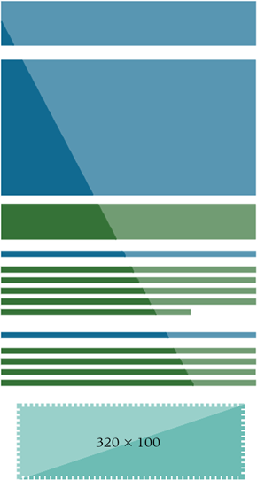
Large Mobile Banner Ad
This ad is displayed only on mobiles.
The standard size of large mobile banner is 320 (width) × 100 (height) pixels.

Slide 14
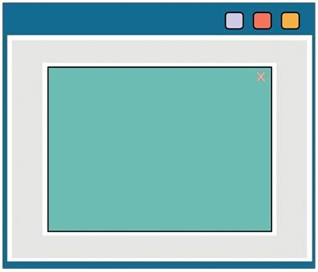
Large Format Ad
This ad covers a large part of the screen.
It may expend on hovering.
This type of ad is also called ‘expendables’.

Slide 15
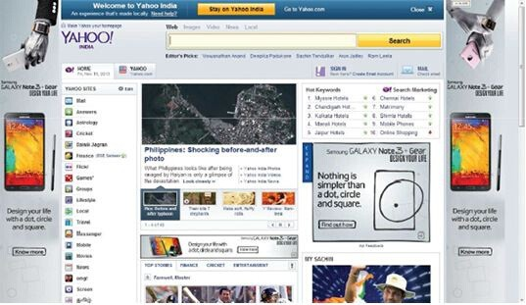
Skinning/Takeover Ad
In these ads, an advertiser takes all the ad spaces on a page.
It is also called ‘Roadblock’ which is popular in newspaper advertising too.
The main objective is to ensure that the users do not miss the ad and get exposed to the brand.

Slide 16
Buying Models
There are mainly 4 different pricing models for display ads.
Cost per Click (CPC)
Cost per Milli (CPM)
Cost per Lead (CPL)
Cost per Acquisition (CPA)

Slide 17
Cost per Click (CPC)
Cost per Click (CPC) is the amount the advertisers are willing to pay for a click on their ads.
CPC model is used solely to drive the traffic to the advertiser’s website.
CPC is comparatively less risky because as an advertiser we need to pay only when someone clicks on our ad.

Slide 18
Cost per Milli (CPM)
Cost per Milli (CPM), also known as Cost per Thousand, is the amount the advertiser must pay for every thousand impressions served.
CPM model is mainly used for brand building purposes.
It ensures that ad reaches a wide range of audience but does not necessarily drive traffic to the website.
This model is preferred by the publishers as they get paid irrespective of clicks.

Slide 19
Cost per Lead (CPL)
Cost per Lead (CPL) is the amount the advertiser pays for acquiring a lead.
Lead is an intermediate action before final purchase (when an user leaves any kind of contact information on our website, it is called a lead.)
It could be a sign up, download of a brochure, subscription, etc.
The objective of the marketer is to acquire leads and nurture them through continuous engagement for conversions.
Example: Consider a company spent Rs. 5000 on a Pay-per-Click (PPC) campaign and 100 users converted to leads. Then, CPL = 5000/100 = Rs. 50 per lead.

Slide 20
Cost per Acquisition (CPA)
Cost per Acquisition (CPA) is the amount the advertiser pays for acquiring a customer who buys product or service.
It typically means the cost of customer acquisition.
Example 1: If we spend Rs. 250 to design a display ad and invest Rs. 500 in the campaign for that ad, that particular campaign cost is Rs. 750. If we acquire 5 customers from that campaign, then CPA = 750/5 = Rs. 150.
Example 2: Assume 100 users click on ad and land on the website. Assume that out of 100 users, 10 people fill a lead form and out of them 1 user buys. Assume that CPC is Rs. 20, then total campaign cost = Rs. 2000, CPL = 200, and CPA = 2000.

Slide 21
Fixed Cost / Sponsorship
In this model, a fixed cost is paid per day irrespective of number of impressions.
YouTube home page banner ads are sold on fixed cost model.
In sponsorship model, we can sponsor a website or a property, wherein we will have logo presence and some ad inventory as part of the package deal.

Slide 22
CPC versus CPM
CTR is an important factor to be considered in order to determine the better of CPC and CPM.
If we have a high CTR, simply displaying the ads on a website might suffice because people are clicking on ads.
If people are not clicking on our ads and we have a low CTR, then we may consider CPC model.

Slide 23
Traditional Display Advertising (Media Buying)
Ad buyers and publishers manually trade digital ads.
Traditional media buying involves a marketer manually negotiating prices, making the purchase directly from a salesperson.
The pricing model for traditional media is based on a predetermined price which is negotiated between the advertiser and the publisher.
In traditional display advertising, we usually optimize our campaigns after they are finished.
Traditional media buying is both inflexible and slow. The amount of human labor in the process is time-consuming, expensive, and leaves a lot of room for error.

Slide 24
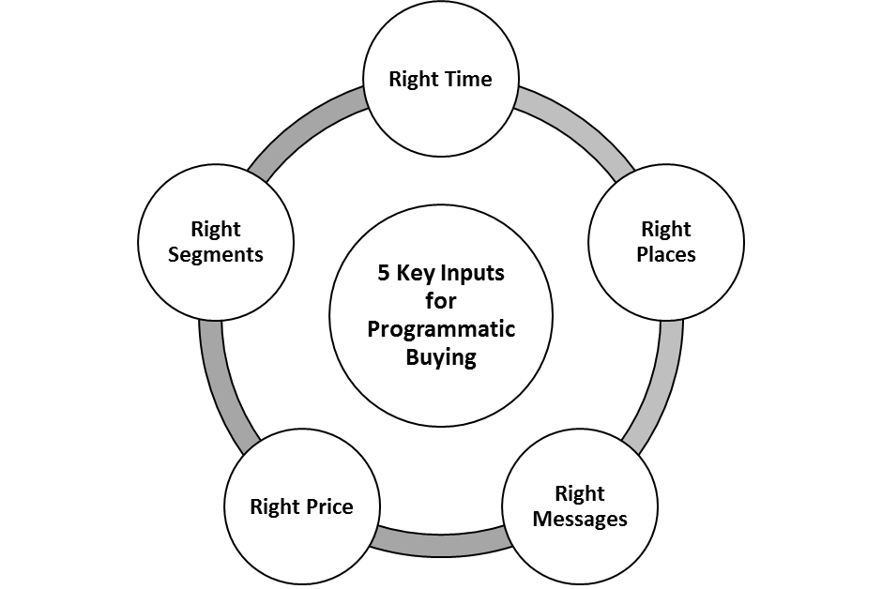
Key Inputs for Programmatic Buying

Slide 25
Programmable Digital Marketing
Programmatic advertising is a way to automatically (using artificial intelligence and machine learning) buy and optimize digital campaigns, rather than buying directly from publishers.
It is also called Real-Time Bidding (RTB) because real-time bidding takes place for ad space on the publisher’s web pages. This allows us to buy ad space almost instantly – across millions of websites.
An algorithm collects and evaluates data and makes decisions about who will see the ad and where – based on which users are most likely to become customers.
Use of RTB has eliminated the advertiser’s risk of overpayment, with the market price being determined by supply and demand.
Programmatic allows us to see – in real time – how our campaign is performing, so we can make informed changes as we go.

Slide 26
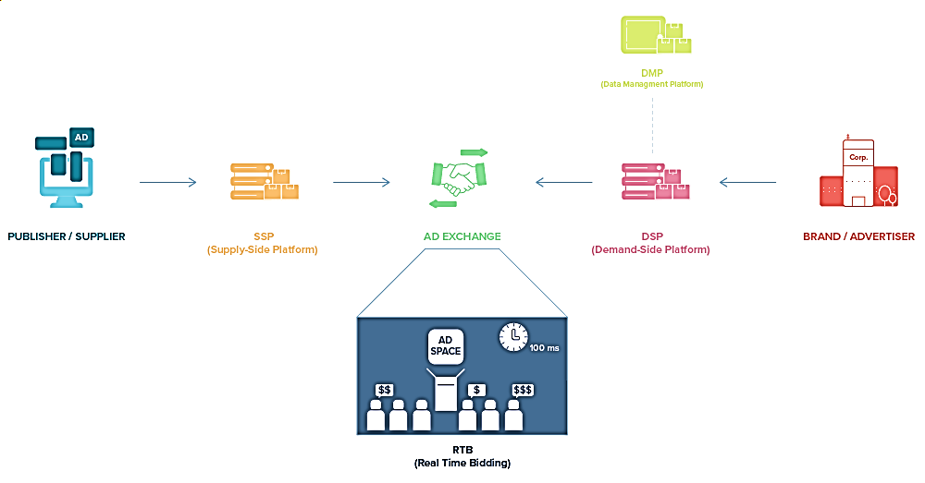
Programmatic Ecosystem

Slide 27

Real-Time Bidding (RTB)
RTB is a way of buying and selling ads through real-time auctions.
Transactions are made in the time it takes to load a web page (around 100 milliseconds).
RTB allows for better and quicker targeting, enabling ads to be bought and sold on a per-case basis, meaning only visitors who are in our target audiences will be subjected to the ad.

Slide 28
Difference b/w RTB and Programmatic
RTB is a form of programmatic advertising, but not all programmatic uses RTB.
Approx. 90% of programmatic buying goes through RTB, there are other ways of programmatic advertising, namely:
Programmatic Direct (A way to buy a guaranteed amount of impressions on specific sites. It involves a fixed-price agreement rather than an auction.)
Private Exchange Buying (A select number of publishers invite specific advertisers to bid on their inventory space. An auction usually takes place, but the terms of the deal are pre-negotiated, creating a more manual environment than RTB.)
RTB is just one part of the programmatic advertising ecosystem.
For a programmatic system to work properly there needs to be other key components in place:
On the advertiser’s side, there would be a Demand-Side Platform (DSP), connected to a Data Management Platform (DMP).
Suppliers (publishers) use a Supply-Side Platform (SSP) to distribute their available inventory across one or multiple Ad-Exchanges.

Slide 29
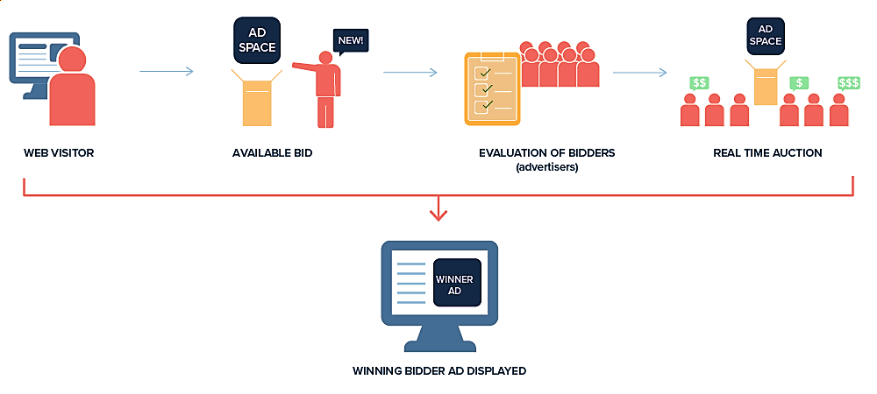
Ad Exchange
An Ad Exchange is where publishers meet advertisers and agree on a price to display their ads.
It functions much like the trading floor of a stock market, but for digital display advertising.
Nowadays, most ad exchanges operate through real-time auctions, where an ad purchase is made at the same time as a visitor loads a website.
Main Ad Exchanges:
Google AdX
Microsoft Ad Exchange
OpenX
AOL’s Marketplace
Smaato
AppNexus
MoPub (Twiter)

Slide 30
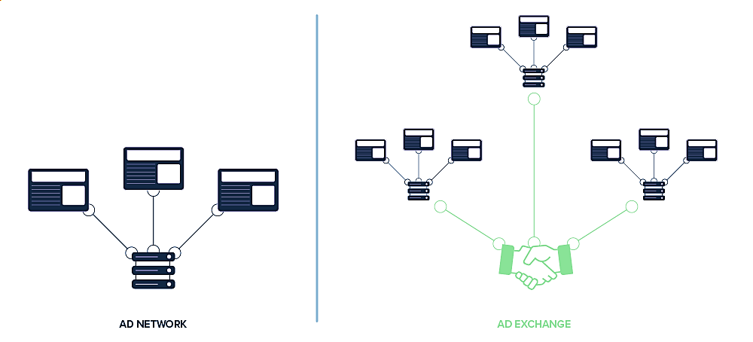
Difference b/w Ad Network and Ad Exchange
An ad network is a platform that is connected to a certain number of websites, and offers inventory for advertisers on those sites
An ad exchange is a trading floor where advertisers can buy ad space from multiple ad networks.

Slide 31
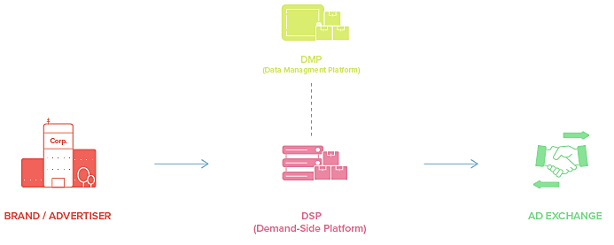
Demand-Side Platform (DSP)
An ad exchange needs data to know which bidders qualify for certain websites and audiences.
This is handled by Demand-Side Platforms (DSP’s) and Supply-Side Platforms (SSP’s).
A DSP is a tool or software that allows advertisers to buy ad placements automatically.
Advertisers use DSP to let an exchange know what they have to offer.

Slide 32
Working of Demand-Side Platform (DSP)
When a visitor reaches a website that’s connected to the ad exchange, an auction signal is sent to the exchange.
The exchange then asks the DSP if the advertiser has any ads that might fit the placement.
If it does, the DSP sends a signal to enter a real-time bidding auction together with other advertisers to compete over the placement.
The winning bidder gets to show his ad to the website visitor.
This is the foundation of programmatic advertising on the advertiser’s side.

Slide 33
Google AdWords as a DSP
AdWords (Google Ads) is a type of Demand-Side Platform – but it’s only limited to Google’s inventory.
Even though the Google Display Network has access to a large percentage of the world’s websites, there are places where they have no reach.
For instance, Facebook display ads are not part of Google’s ad inventory.
It means if we run our campaigns through Google Display Network, they will not be displayed on Facebook.
As an advertiser, we would generally want to have access to as much inventory as possible.
With Match2One, we get access to the Google Display Network and other ad networks like AppNexus.

Slide 34

Supply-Side Platform (SSP)
Publishers use a SSP to manage their display space.
The SSP connects to an ad exchange and tells it what kind of inventory is available – and through Real-Time Bidding this inventory is automatically auctioned off to the highest bidder.
An SSP can connect to several different ad exchanges in order to maximize the publisher’s exposure to potential buyers.

Slide 35
Supply-Side Platform (SSP) (contd…)
A DSP’s job is to buy programmatic ad space as cheaply as possible from publishers while an SSP has the opposite function – selling ad space for the highest possible price.
Through an SSP a publisher can also control inventory in a more efficient way; they can set minimum prices and dictate specific buyers or specific channels.
AppNexus, Google for Publishers, MoPub, OpenX, ONE by AOL, PubMatic, etc. are main supply-side platforms.

Slide 36
Data Management Platform (DMP)
A data management platform is used to collect, store and sort information.
DMP’s are most often used in combination with a Demand-Side Platform on the advertiser’s side – or a Supply-Side Platform on the publisher’s side.
In order to properly target ads to specific visitors, a DMP needs to be in place to sort and segment incoming cookie data.

Slide 37
Analytics Tools for Display Advertisement
There are some issues plaguing the display advertisement industry.
Some tools have been developed to overcome such issues:
Viewability
On Target Reach
Ad Fraud
Brand Health

Slide 38
Analytics Tools: Viewability
As per Integral Ad Science & Media Rating Council Data in 2015, 57% display ads were not viewable.
Ad may not be visible due to disruptive human behaviour (such as action taken before ad loads and renders, compromised pages).
It could be because ad loads in area out of the user’s browser, or frequent page refresh prevents ad load, or web load gives error.
In May 2015, Media Rating Council has prescribed following conditions for viewability of ads:
Display ads are considered viewable when at least 50% of the ad is visible for at least 1 second.
Video ads are considered viewable when at least 50% of the ad is visible while the video is playing for at least 2 consecutive seconds.

Slide 39
Analytics Tools: Viewability (contd…)
If the pixel and time components associated with an ad are greater than 0, but one or both do not meet the minimum requirements, the ad may be referred to as ‘loaded ad’.
It should not be considered as impression.
Viewable impression tracking can detect user behaviors which restrict ad viewing, such as:
Ad-blocking software
Screen resolutions too small for the ad to appear on screen
People were scrolling down before the requested ad loads
Broken plugins are restricting content display
The user minimized browser windows
User movement between different applications
Pages loaded in background tabs then never accessed
Non-user interference, such as malware cloaking ads

Slide 40
Analytics Tools: Viewability (contd…)
To address the viewability issue, tools such as Integral Ad Science and Moat provides metrics such as:
In-view impressions and out-of-view impressions
Viewable rate (the percentage of time when ad appeared on sites or apps with active view enabled and was viewable)
Note:
Impressions are when an ad or any other kind of digital content renders on a person’s screen.
Views are the number of times visitors watch or engage with your digital content, especially your video ads.
Reach calculates the number of unique visitors who view your digital media.
If you post an article to your 1,000 followers on social media, your reach would be a maximum of 1,000, even if one of your followers sees the article again from a friend sharing the same post. On the other hand, your impressions will increase every time somebody sees your post, even if they’ve seen it before.

Slide 41
Analytics Tools: On Target Reach
In 2017, a study by Flash found that for an advertiser 64% of cookies were rejected.
Cookie rejection occurs when browsers block a cookie being placed or deletes it afterwards.
The cookie-based approach tends to overestimate unique reach and underestimate the actual frequency.
The ad servers measure cookies, where they count how many they see. The problem is that people delete cookies from the browser and use multiple devices.
For example, if a consumer viewed an ad on a desktop and purchased it on mobile, the advertiser will not know that it’s the same person. The user may view something on a retailer’s website via laptop and then later purchase the item on a mobile device. If user is logged in the retailer knows the customer, but if the customer is not logged in, he/she keeps seeing the same ad for what seems like all time.

Slide 42
Analytics Tools: On Target Reach (contd…)
Atlas (a tool of Facebook) is used to measure publisher-wise on-target reach for each campaign.
It is based on Facebook’s logged-in data.
Nielsen Digital Ad Ratings tool does cross device management and provides reach overlap reports.
These tools determine accuracy based on real logins of peoples across mobile and desktop.
They enable people-based marketing.

Slide 43
Analytics Tools: Ad Fraud
Domain Spoofing
Domain spoofing happens when a low-quality publisher disguises itself as a premium publisher in a programmatic marketplace.
Spoofing a premium publisher makes the ad impressions more valuable and the demand will also be typically high.
Advertisers believe their ads are showing up at the premium websites, for the right audience. However, the fraudsters will show them up at the low-quality websites.
Generally, fraudsters build a domain that closely resembles the URL of legitimate publishers. Not only do they create fake domains, but they can also create a duplicate copy of the website’s content.

Slide 44
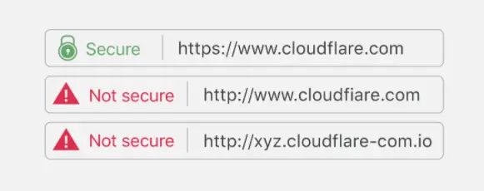
Analytics Tools: Ad Fraud (contd…)
Example of Domain Spoofing
The Financial Times (FT.com) ran an audit in 2017 and found that FT.com has been spoofed and fraudsters via these spoofed domains were selling display inventories on 10 ad exchanges and video ads on 15 exchanges. The money will never reach the publisher as the website is not even theirs.
Integral Ad Science and WhiteOps offer tools to detect advanced domain spoofing types.

Slide 45
Analytics Tools: Ad Fraud (Contd…)
Click Fraud or Click Injection
This type of fraud involves generating fake traffic through either automated clicking platform, or by running click farms. This boosts the CTR of ads, but never results in a sale.
Ad Stacking
Multiple ads are layered on top of each other in a single ad placement. Only the top ad is visible. If a user clicks on the visible ad, a click is registered for all ads in the stack.
Although only one ad unit gets viewed or clicked by the user, each advertiser pays for the impressions.
High impressions counts with low conversion rates are a tell-tale sign of ad stacking practices.
PubGuru Ad Inspector tool helps the publishers check the ad stacking.

Slide 46
Analytics Tools: Ad Fraud (Contd…)
Pixel Stuffing
A fraudster creates a tiny, typically 1 x 1 pixel area, advertising display that a normal person would never see.
Using pixel stuffing, a criminal can display dozens or even hundreds of ads on a single webpage and get credit for impressions.
These single-pixel ads do not generate results since viewers will never even realize that they “saw” an ad.
Due to their nature, cost-per-mille compensation models carry a high-risk for impression-based ad fraud - such as pixel stuffing. Moving to cost-per-click models carries a lower risk for impression fraud, but has risk vulnerability to click fraud.
Opticks provides anti-fraud solution tools to prevent pixel stuffing.

Slide 47
Analytics Tools: Brand Safety
In following situations, the ads, appearing alongside content, could damage the brand or reputation:
Ads appearing on sites publishing illegal content. (Example: Adult, illegal downloads)
Ads appearing alongside user generated content. (Example: Controversial opinion)
etc.
Brand safety is ensured by blacklisting websites (using keywords to not show ads in that context and by labeling content for adult use.) having controversial content.
To prevent brand health from getting compromised, Integral Ad Science tool dynamically score individual pages to know exactly what type of content will appear with our advertising.

Slide 48
YouTube Advertising
With immense audience presence, YouTube is a great platform to promote our brand.
On YouTube, marketers have two broad areas of participation:
YouTube Channel
Companies can promote their brands and products by creating quality video content and curating it into a YouTube channel.
YouTube Ads
YouTube allows to display ads in different formats (Display Ads, Overlay Ads, Skippable Video Ads, Non-skippable Video Ads, Mid-roll Ads, Bumper Ads, Native Mobile Ads, Discovery Ads)

Slide 49
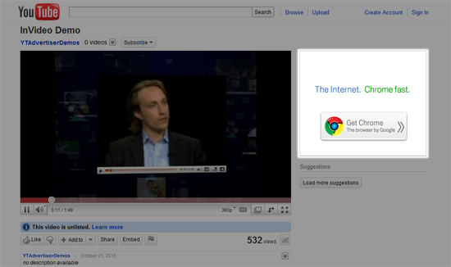
YouTube Ads: Display Ads
Ads appear next to the our video while accessing YouTube on a laptop or desktop.
This ad format is not available on mobile device.
These ads can be purchased in CPC and CPM model.

Slide 50
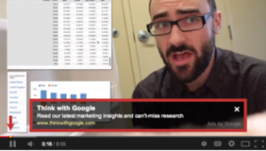
YouTube Ads: Overlay Ads
An overlay ad appears in a rectangular format in the bottom 20% of the video.
This ad format is not available on mobile device.
These ads can be purchased only in the CPC model.
Viewers can dismiss the ad any time.

Slide 51
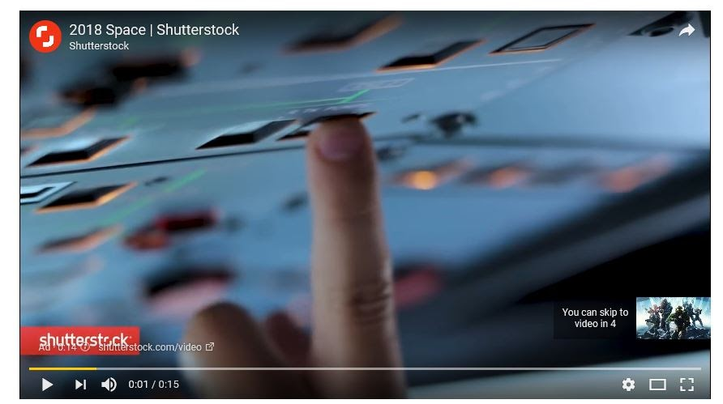
YouTube Ads: Skippable Video Ads
Skippable video ad is the most popular advertising format on YouTube.
Viewers can skip the ad after watching it for 5 seconds.
This ad format is available on desktop and mobile devices.
It has a very unique buying model wherein the publisher is paid only when a user watches 30 seconds of video or till the end of video – whichever comes first.

Slide 52
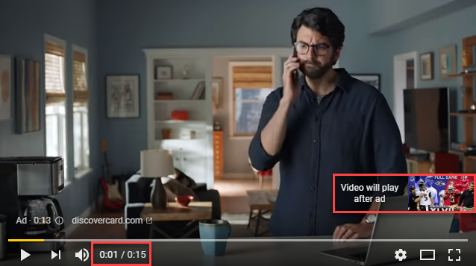
YouTube Ads: Non-Skippable Video Ads
Non-skippable video ads are 15-20 seconds long video ads which can be inserted before, during or after the YouTube video.
As per the name, viewers can not skip the ad.
This ad format is available on desktop and mobile devices.
For these ads, the publisher is paid only when a user fully watches the ad.

Slide 53
YouTube Ads: Mid-Roll Ads
Mid-roll ads are available for YouTube videos over 15 minutes.
These ads are spaced between the video, similar to TV commercials.
For better viewing experience, publishers can choose to place their ads at natural pauses between the scenes.
These ads could be skippable or non-skippable ads, and the pricing model is as per the chosen format (skippable or non-skippable).
These ads are available for desktop and mobile devices.

Slide 54
YouTube Ads: Bumper Ads
Bumper ads are six-second, non-skippable video ads that play right before an actual video.
These ads are perfect for anyone who has a simple message to get across and doesn’t need the full production of a minutes-long video.
These ads are a great spot for any awareness efforts like promoting an event, or driving brand reach and frequency.
Similar to non-skippable ads, the publisher is paid only when the user fully watches the ad.

Slide 55
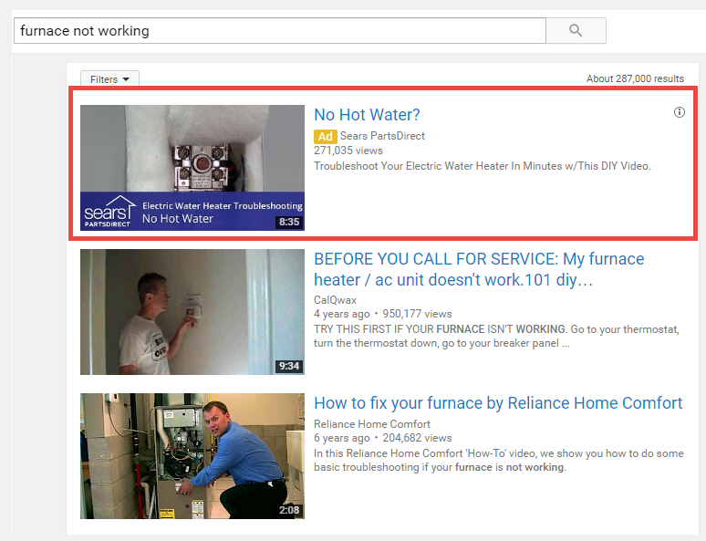
YouTube Ads: Discovery Ads
These ads are similar to Google search ads, appearing amongst search results.
These ads are composed of a thumbnail image and three lines of text.
Skippable and Discovery ads that come in the search results are called TrueView ads as users choose to see the ad by their own choice.
TrueView ad format is available either in-​stream or video discovery ads.
The publisher is paid whenever a user clicks on a video thumbnail or title, and begins watching ad video.

Slide 56
General Guidelines for Videos Ads on YouTube
On YouTube, users do not prefer to click and leave the site.
Therefore, we should create videos which are standalone and are effective without requiring the user to go to the landing page.
The first five seconds of ad video (when the viewer can skip) should be very compelling.
The ad message should be conveyed in the first five seconds itself.
The video ad should be created especially for YouTube instead of TV commercials.
It is good idea to keep the videos short (approx. 30 seconds)

Slide 57
Buying Models for YouTube Ads
Cost-Per-View (CPV)
Cost-Per-Milli (CPM)
Cost-Per-Day (CPD)
Reserved Media Placements

Slide 58
Cost-Per-View (CPV) Model (YouTube Ads)
CPV is the amount an advertiser pay for each TrueView video view or interaction (such as clicks on call-to-action overlays).
A view is considered when a viewer watches atleast 30 seconds of video ad or full view of ad if it is shorter than 30 seconds – whichever comes first.
In case of TrueView in-stream video, there are two possibilities:
The viewer watches atleast 30 seconds or complete add if it is shorter than 30 seconds – whichever comes first.
The viewer clicks on the ad.
If maximum CPV is Rs. 40, the advertiser needs to pay Rs. 40 for either of the above two actions, whichever occurs first.
An advertiser always does not pay the maximum CPV amount as it is a competitive bidding model.

Slide 59
Cost-Per-View (CPV) Model (YouTube Ads)
In bidding model, the advertiser might often strike a deal at a lower price relative to the maximum CPV.
The price at which the advertiser strike a deal is called the actual CPV.
The actual CPV depends on two factors: Quality Score and Ad Rank.
Quality score is a measure of how relevant the ad is to a customer and includes multiple performance factors such as view rates or click rates.
Ad Rank = Max CPV × Quality Score
Based on the Ad Rank, all the bidders are ranked.
If the quality score of ad is low, the advertiser needs to bid high.

Slide 60
Cost-Per-Milli (CPM) Model (YouTube Ads)
In a CPM campaign, an advertiser is billed for every 1000 impressions.
Following ad formats fall under this model:
Non-skippable Video Ads
Skippable Video Ads
The ad can be upto 60 seconds long and the viewer is allowed to skip the ad after 5 seconds.
Impression is recorded irrespective of the user skipping the video.

Slide 61
Cost-Per-Day (CPD) Model (YouTube Ads)
The CPD is the amount charged to publish the ad for an entire day.
Following ad formats fall under this model:
Desktop Masthead
Mobile Masthead

Slide 62
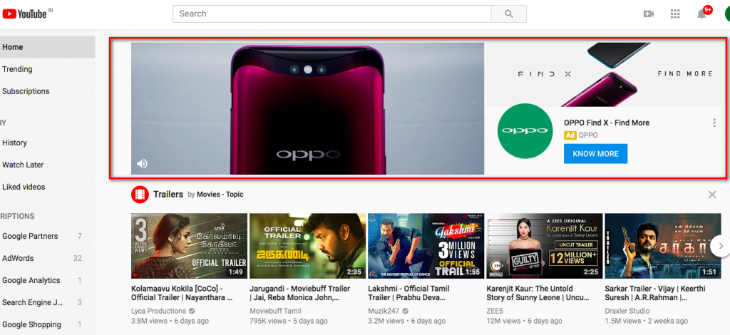
Cost-Per-Day (CPD) Model (YouTube Ads)
Desktop Masthead

Slide 63
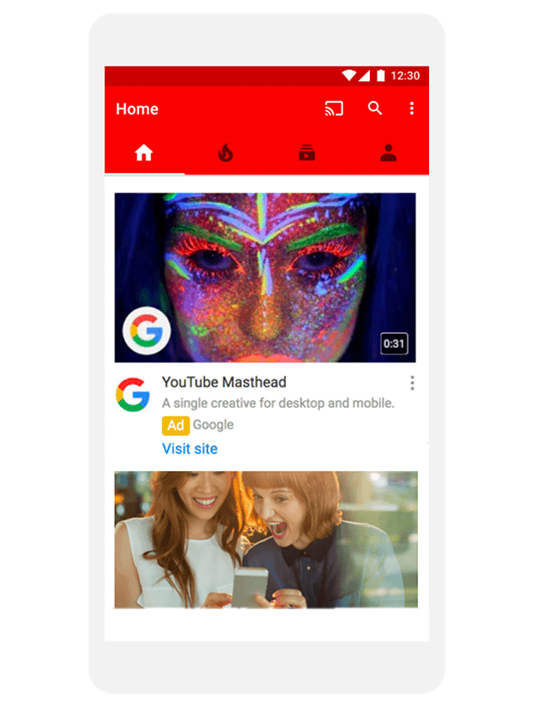
Cost-Per-Day (CPD) Model (YouTube Ads)
Mobile Masthead

Slide 64
Search Engine Advertising: Background
Search Engine Marketing has two parts:
Search Engine Optimization (It is organic.)
Search Advertising (It is paid.)
The results of SEO may come only after few months of following the best practices of SEO.
The marketer must have presence (through paid search advertising) on search engines when the user is searching.
Search engines try to ensure that advertisements are highly relevant to the user’s query.

Slide 65
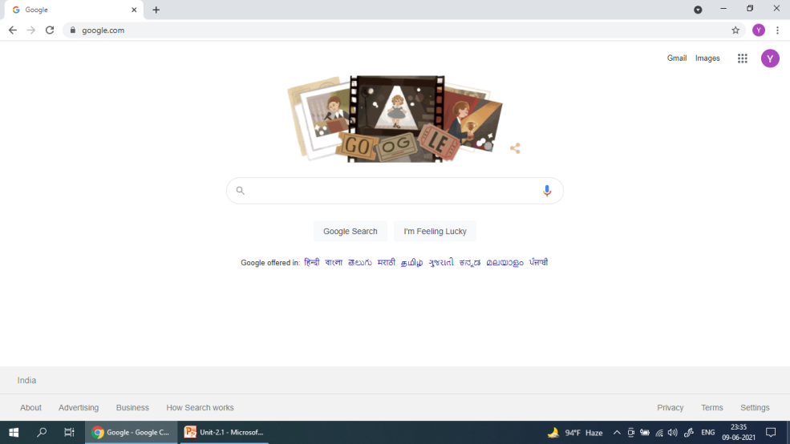
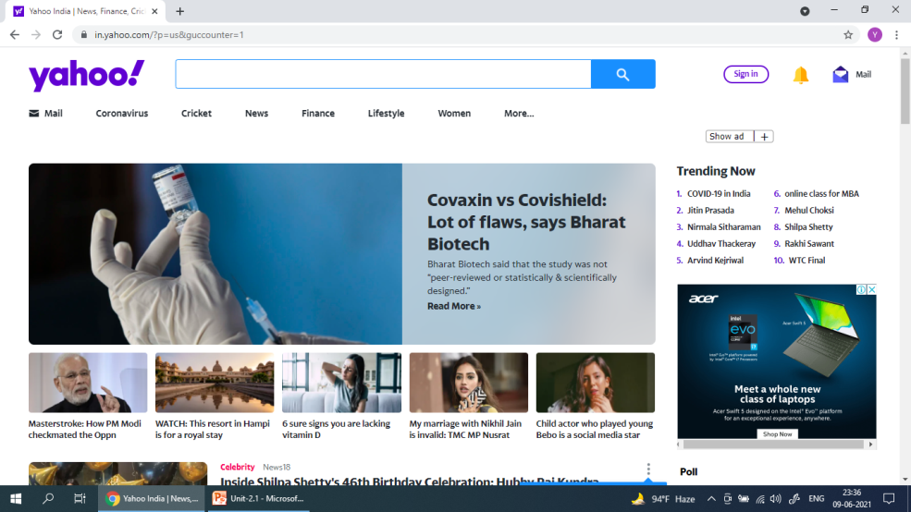
Google v/s Yahoo
Google’s primary business is search, and hence Google does not display any ad on its home page.
Yahoo’s focus is on content, and hence Yahoo displays ads on its home page.

Slide 66
Importance of Search Advertising
If organic results are free then why a marketer spend money on paid results?
The algorithm for organic results is complex and not under the control of marketer.
Competitors’ websites may be more relevant for certain search queries.
The marketer could secure a higher position on paid results by paying for the ads.
Following are some reasons for paid search advertisements:
Intent
Ease of action
Controlled cost
Analytics
Competition

Slide 67
Importance of Search Advertising (contd…)
Capture Intent
The advertisement is shown to the people who are searching for terms that are relevant to advertiser’s business.
These people are actively searching because they are interested in either finding out more information about the product or service or going to buy it.
These users have interest and intent, and are more likely to click on the ad and buy the product or service.
This makes search advertising more powerful.
This is the primary reason why CTR are highest for search advertisement among all platforms of digital advertising.

Slide 68
Importance of Search Advertising (contd…)
Ease of Action
Search engine ads are meant to be clickable.
Once a person clicks on the ad, he/she is directed to the brand’s web page.
The web page has navigation links to various parts of the website which enables the person to find relevant content.

Slide 69
Importance of Search Advertising (contd…)
Controlled Costs
Search engines charge a marketer only if a person clicks on the ad (cost per click model).
The advertisers are not charged for impressions (number of times the ad is shown in the search results).
One can control how much they are willing to pay for each click.
An account can be charged on a prepaid model where the advertisers transfer money to search engine, and subsequent costs are deducted from this amount.

Slide 70
Importance of Search Advertising (contd…)
Analytics
Search engines help in creating and downloading reports about the performance of ads.
The advertisers can view statistics such as – number of clicks for each ad, total amount spent, click through rate, number of impressions to analyze the effectiveness of campaign.

Slide 71
Importance of Search Advertising (contd…)
Competition
Example: When Flipkart ran the campaign - Big Billion Day, Amazon showed ads against the keyword and purchased the ‘Big Billion Day’ domain name. Amazon also showed ads on web pages which had the keywords – Big Billion Day. When people clicked on Big Billion Day website, they were redirected to Amazon site. --> This is called ambush marketing.
Even though one company may earn the first rank in organic results, it should bid for top ad slots not for visibility alone but to prevent competition.
If the company does not bid for the top ad slot, the competitor will win and the competitor's results will be listed on top of the search results page through paid ad.

Slide 72
Ad Placement
Search engines show advertisements in predefined areas on the result pages. Google mainly shows the ads in two areas – top and bottom.
It is not necessary that the search engines will display all potential ads on result page.
The reason is that there is the huge cost of serving ads.
Algorithm is optimized for the probability of click as the advertiser pay only when they receive a click.
Hence, search engines show ads only when the probability of click is higher than the threshold level.
Completing the entire process of running a live auction in real time every time a user types a query entails a huge cost of server and technology.
When the cost of serving ads is high and the probability of clicking is low, search engine may not show ads.
This is called coverage which may increase during festivals when the intent to buy is high, and hence search engines show more ads.

Slide 73
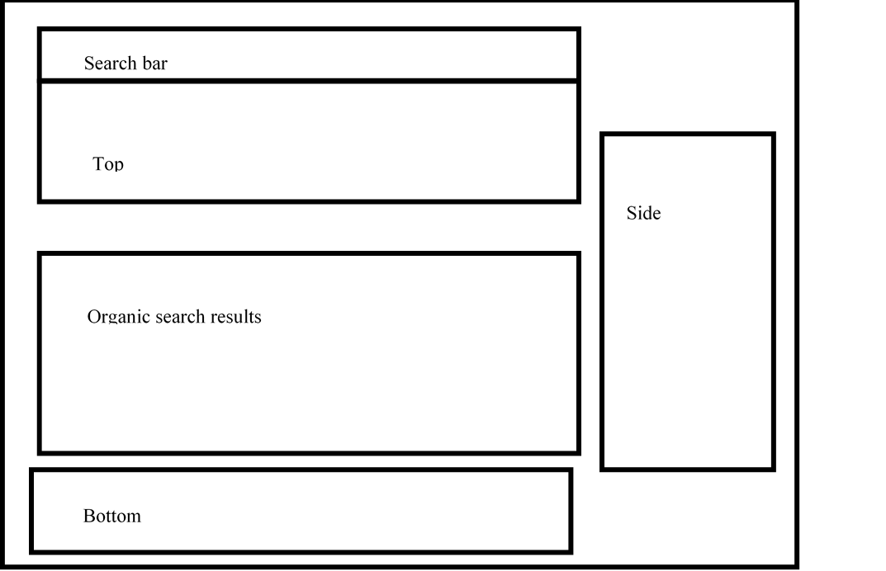
Ad Placement of Google
A typical Google search result page

Slide 74
Ad Placement of Google: Top
Top
The top position is considered as the prime location in search engine result page.
Users usually click on results on the first page and that too which are above the scroll
The competition is for the top four positions on the first page, and click rates are high for them.
The ads are called native ads as they come in the same place where organic results come.

Slide 75
Ad Placement of Google: Side
Side
The side has only ads without organic results, so users pay more attention to results of main section.
Click rates of right side were very low as they were not native.

Slide 76
Ad Placement of Google: Bottom
Bottom
If the AdRank for an ad is lower than the threshold for the Top position, in that case (even if the top position does not show any ad), the ad is shown in the bottom area.
Google categories the bottom ads as ‘others’.
The other ads are unique for each page of the results.
Google does not repeat ads shown in ‘other’ slots rather would show newer ads in subsequent pages of results.
Ads in the ‘other’ slot, however, may be shown in the top slot in one of the result pages.

Slide 77
Appearance of Ads on Google Result Page
Page | Top Slots | Other Slots
Page 1 | Ads 1-4 | Ads 5-7
Page 2 | Ads 1, 2, 5, 6 | Ads 3, 8-10
Page 3 | Ads 1, 2, 7, 8 | Ads 4,11-12

Slide 78
Ad Rank
Ad Rank is the position at which the ad appears in the search engine results.
A study by Chitika (2013) has shown that the results which appear in the top three positions combined attract more than 60% of traffic compared to all other results.

Slide 79
Ad Auction Model in Search Engine
Biding is done for keywords.
The auction model of Google search ads is based on AdRank.
AdRank = Maximum Bid × Quality Score
Based on the AdRank, all the bidders are ranked for the keywords.
Google does not provide weights of the components of the Quality Score.
Some analytics companies have analyzed the quality score of keywords at large scale, and drawn some inferences about weights.

Slide 80
Quality Score of Ad: Landing Page
Each ad has a target URL configured for it, which, upon clicking, takes us to the landing page.
The content of the landing page must match the ad.
In addition to the content match, search engines also look at the quality of the landing page.
A good landing page has relevant and original content.

Slide 81
Quality Score of Ad: Click Through Rate
Click Through Rate (CTR) is highest for search ads as they capture the intent of users and are a pull medium.
If more people find the ad relevant and interesting, they will click on the ad, and the CTR will go up.
CTR is the most important factor having highest weight of 55% in the quality score.
Ads will be shown only when they meet certain threshold quality scores.

Slide 82
Quality Score of Ad: Relevance
Search engines give importance to relevance since high relevance indicates better user experience.
First, it is whether the search query of the user matches with the keywords that we are bidding for.
Second, it is whether your keywords are appearing in the ad headlines and description.
Out of all the components of quality score, relevance is the easiest to change and control.
Hence, a new advertiser must strive to improve the quality score by improving relevance.

Slide 83
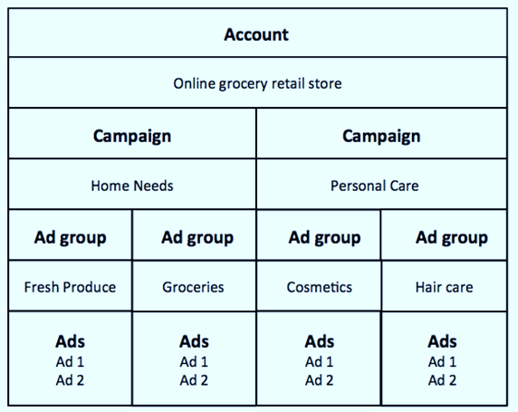
Creating Ad Campaigns
Architecture of Search Advertising Account (for Ads on Google Search Engine) - Consider the case of an Online Grocery Store
Google AdWords Account
Campaigns
Ad Groups
Ads

Slide 84
Google AdWords Account
If the advertiser has an existing account with Google, he/she can use the same details to log-in to AdWords.

Slide 85
Campaigns
An important setting at campaign level is the daily budget which allows to set daily expenditure possible for the campaign.
One can have multiple campaigns region-wise to save the cost.
It can be chosen to show ads only on Google or on all search partners.
An important setting is bidding model where the advertiser can chose amongst Cost per Click, Cost per Lead, or Cost per Acquisition. Most advertises go for CPC model.
Another important setting is location (geographical location or location of interest).
Geographical location refers to physical location of the user, whereas location of interest means that the user is geographically not in the location but is interested in that location.
Interest is determined by user’s search query having location as the phrase while geographic location is determined with the help of IP addresses or domain.

Slide 86
Campaigns (contd…)
Google allows a user to search for region-specific domains such as ‘google.co.in’ instead of the universal ‘google.com’.
In case users in England search for ‘Restaurants’ on Indian domain, they will be shown ads targeted for India and not for England.
In case users in England search for ‘Online Grocery in Agra’, they will be shown ads targeted for India
Ads can be created in different languages.

Slide 87
Ad Groups
Each campaign is made up of one or more ad groups.
As ad group is a bundle of keywords and ads.
The best practice is to have 10 – 15 tightly themed keywords in an ad group.
Advertiser can make multiple ads in an ad group.
When a user searches for a keyword, the ads are shown in rotation.
In AdWords, default bid can be set at the group level – the bid is applied to all keywords.
One can also set bids for individual keywords. In such a case, keyword bids will override the ad group bid.

Slide 88
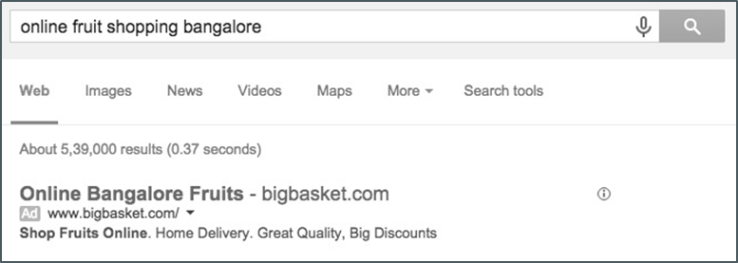
Ads
Google provides a preview tool for ads within AdWords which can be used by the advertisers to know whether their ads are showing or not for certain keywords.
An ad shown on the search engine result pages has three main components:
Headline
URL
Description

Slide 89
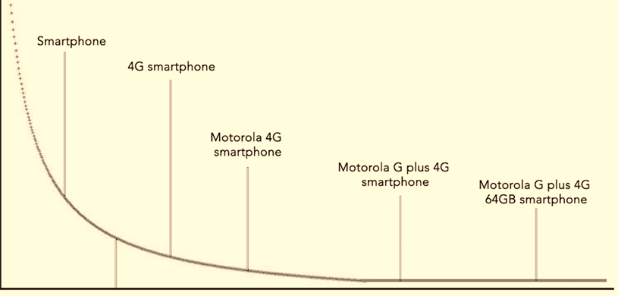
Keywords
Keywords are the single most important component of the search engine advertisement.
Appropriateness of keywords determine whether the ads are reaching the target audience or not.
Short Tail and Long Tail
Keywords
When Search volume is low for the
give keywords, CPC will be lower.
Google give quality score ( 1 to 10)
for each Keyword based on all 3
dimensions.
Score 9 is considered very good
Score 10 is considered excellent.
Search Volume

Slide 90
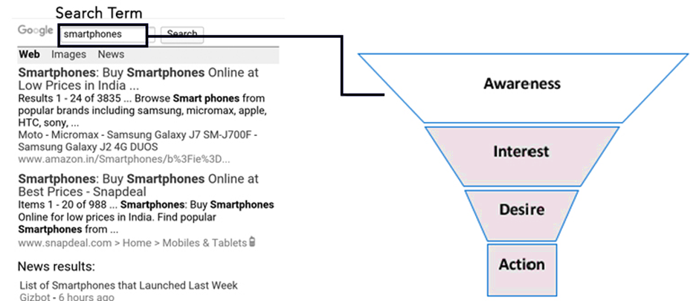
Keywords (contd…)
One can also map keywords to the consumer buying funnel. The user query can help in determining at what stage of the buying cycle the user is in.

Slide 91
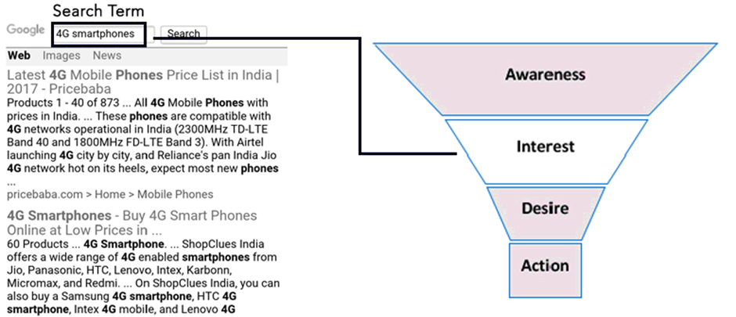
Keywords (contd…)

Slide 92
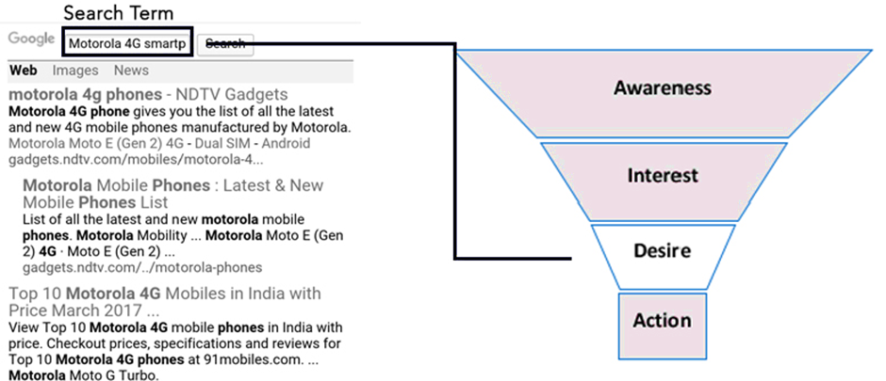
Keywords (contd…)

Slide 93
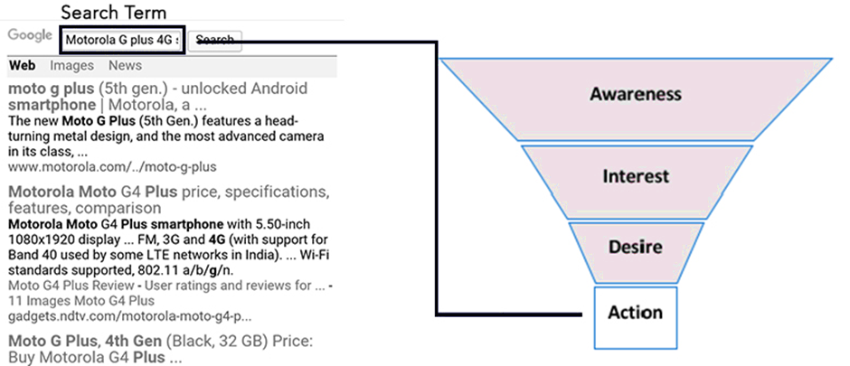
Keywords (contd…)

Slide 94
Performance Report
Advertiser must generate performance reports for campaigns, ad groups, keywords and ads.
In AdWords, these reports can be easily generated from the ‘Reports’ tab.
Based on the reports, one can pause or modify weak performing units and put more budget on high performance units.
Search Terms: It is one of the most useful reports which shows the search terms that users queried that triggered their ad.
Auction Insights: This report is useful for getting some insights about other players who are participating in the same auctions as the brand, and check their performance regarding impressions, ad position, AdRank, etc. based on sample data only.

Slide 95
Email Marketing: Introduction
Email marketing is, quite simply, using the tools of email to deliver advertising messages.
Email is one of the fastest, cheapest and easiest ways for marketers to connect with customers.
Email marketing is used to reach directly to customers encouraging them to trial and purchase of new products and services.
Email marketing is also used to receive inquiries from customers for any kind of support.
Email is a remarkably flexible tool that can accommodate a wide range of messages.
Ads can be quite simple, or they can be flashy, multimedia packages.
Some ads are only text while others include images, video, and long lists of links.

Slide 96
Email Marketing: Introduction (contd…)
Outbound Email Marketing: Campaigns are used as a form of direct marketing to encourage trial and purchases.
Inbound Email Marketing: Emails from customers such as support enquiries are managed.
Type of Emails:
Email Newsletters
Transactional Emails
Direct Emails

Slide 97
Types of Emails: Newsletters Emails
These are regular emails that are sent to a list of subscribers who have chosen to receive updates from a company.
Newsletters usually don’t have explicit sales messages, but try instead to build a relationship between a customer and a brand.
They contain news and information that will be of interest to the customer.
The goal is to keep a customer connected to a company even when they are not buying anything.

Slide 98
Types of Emails: Transactional Emails
These are emails that are sent out after certain actions trigger them.
When a customer buys a product or makes a reservation, emails are sent out confirming that transaction.
They legitimize online commerce by giving customers a way to prove they have bought something.
Transactional emails often also contain new sales messages.
Marketers often try to insert new sales pitches into emails that are not explicitly for selling. For example, airline reservation emails often ask if you would like to upgrade your seat for a fee.
Studies have shown that transactional emails are opened 51.3% of the time, while newsletters are only opened 36.6% of the time.
.

Slide 99
Types of Emails: Direct Emails
These are used to inform customers about new products, sales and special offers.
They provide customers with direct information about products and usually provide a link or another easy way for customers to access the product.
They are similar to the coupons, catalogs, and sales fliers.
----------------------------
Email marketing is not used only for selling products online – non-profit organizations and political campaigns also make use of email to connect with supporters and donors.
It is now standard to ask for an email address when collecting information from interested parties.

Slide 100
Email Campaign
Email marketing is an inexpensive and easy way to connect with customers.
The only significant disadvantage of email marketing is that many countries have laws against sending spam. Companies that send out unsolicited emails can face significant fines.
The first step is to collect a comprehensive list of email addresses.
Designing the look and feel of the email is an important process.
The email needs to grab the reader’s attention and draw them into the details of the sales pitch as quickly and succinctly as possible. If the email is confusing or boring, readers are likely to delete it before reading too far into it. All of that effort is then wasted.

Slide 101
Email Campaign (contd…)
Deciding which customers receive which emails is a way to give marketing messages relevance.
Matching the message to the customer leads to higher sales and greater levels of customer satisfaction. Email marketing software makes it easy for companies to segment their email delivery based on criteria that they establish.
It is important to make the process easy for customers to sign up for email updates - Incentives like one time coupons may be offered to encourage higher subscription rates.
After an email campaign is sent out, it will be important to track and evaluate the success of that campaign.
If a campaign is not performing well, marketers can change the design of the ads, the products being emphasized, or the deals being offered. The flexibility of email makes it easy to implement changes quickly and inexpensively.

Slide 102
Email Marketing Success Factors: CRITICAL
Creative – This assesses the design of the email including its layout, use of Colour and image and the copy.
Relevance – Does the offer and creative of the email meet the needs of the recipients?
Incentive (or offer) – The WIFM factor or ‘What’s in it for me?’ for the recipient. What benefit does the recipient gain from clicking on the hyperlink(s) in the e-mail? For example, a prize draw is a common offer for B2C brands.
Targeting and Timing – Targeting is related to the relevance. Is a single message sent to all prospects or customers on the list or are emails with tailored creative, incentive and copy sent to the different segments on the list? Timing refers to when the email is received: day of the week, point in the month and even the year.
Integration – Are the email campaigns part of your integrated marketing communications?
Copy – This is part of the creative and refers to the structure, style and explanation of the offer together with the location of hyperlinks in the e-mail.
Attributes (of the e-mail) – Assess the message characteristics such as the subject line, from address, to address, date/time of receipt and format (HTML or text). Send out MIME messages which can display HTML or text according to the capability of the email reader. Offer choice of HTML or text to match users’ preferences.
Landing page (or microsite) – These are terms given for the page(s) reached after the recipient clicks on a link in the email. Typically, on click-through, the recipient will be presented with an online form to profile or learn more about them. Designing the page so the form is easy to complete can effect the overall success of the campaign.

Slide 103
Key Measures for Email Marketing
Delivery Rate (Non-Bounce Rate) – Emails will bounce if the email address is no longer valid or a spam filter blocks the email. So online marketers check their ‘deliverability’ to make sure their messages are not identified as ‘false positives’ by spam prevention software.
Open Rate – This is measured for HTML messages through downloaded images. It is an indication of how many customers open an email, but is not accurate since some users have preview panes in their email readers which load the message even it is deleted without reading. Some email readers such as Outlook Express now block images by default (this has resulted in a decline in open rates).
Click Through or Click Rate – This is the number of people who click through on the email of those delivered (strictly unique clicks rather than total clicks).

Slide 104
Opt-in-Email Marketing
Opt-in email is a term used when someone is given the option to receive email.
Without obtaining permission before sending email, the email is unsolicited bulk email, better known as spam.
There are several common forms of opt-in email:
Unconfirmed opt-in / Single opt-in
Confirmed opt-in / Double opt-in
Opt-out

Slide 105
Unconfirmed opt-in / Single opt-in
Someone first gives an email address to the list software (for instance, on a Web page), but no steps are taken to make sure that this address belongs to the person submitting it.
This can cause email from the mailing list to be considered spam because simple typos of the email address can cause the email to be sent to someone else.

Slide 106
Confirmed opt-in / Double opt-in
A new subscriber asks to be subscribed to the mailing list.
A confirmation email is sent to verify it was really subscriber.
A confirmed opt-in (COI) (also known as a Double opt-in) procedure helps to ensure that a third party is not able to subscribe someone else accidentally, or out of malice, since if no action is taken on the part of the e-mail recipient, they will simply no longer receive any messages from the list operator.

Slide 107
Opt-out
Instead of giving people the option to be put in the list, they are automatically put in and then have the option to request to be taken out.
This approach is illegal in the European Union and many other jurisdictions.

Slide 108
Online PR
Public Relation (PR) is a kind of a bridge between the organization and customer.
When PR is connected to online world, it means that the public relation person is telling the policies of company or organization online using Internet on some particular website and promoting the products throughout the worldwide.
PR is an integral part of company’s marketing strategy.
Public relation practitioner is the person or department which promotes the positive image of their respective company or organization.
Public relation department deals with the people in such a way that they have to build the positive image of their product that it’s the best one and they will not be able to find the better product in society.

Slide 109
Online PR (contd…)
Public relation person or department makes the company’s websites interactive and promote their products in such a way that the audience finds all the benefits and advantages of the product or organization and think that this is the best organization or brand to grab the product or do work.
Example: Promoting the Facebook pages of brands and organizations. Once the people like their page, they get the updates of the respective company or product on their newsfeed on daily basis that helps the brand or organization in increasing their business.
The role of public relation department in such type of online world can be judged when any person comment or ask something about their product or organization, the public relation person has to answer that in such a convincing way that the other person gets satisfied.

Slide 110
Online PR (contd…)
Nowadays, people have started rating companies, and, if a company does not have an active website or the Facebook page of that company has less ‘likes’, then people are less likely to buy products of that company.
Characteristics of Online PR
Immediacy: The response in social media is measured in minutes so a PR person has to be actively engaged to the online profile of his company before other companies grab the narrative.
Direct Engagement: Social media demands an online engagement where the PR person has to be answerable to the public in an honest and open manner.
Transparency: This means that everything is open on social media so the PR person has to be very careful in building a positive image of the company.
Reach: This is the greatest benefit of the online world as it allows promoting and managing the brand on a global scale with minimum expenditure.

Slide 111
Principles of PR in Online World
Face up to Crisis - The companies who indulge in crisis should accept their faults , write a sorry note for customers in their online profile and should also promise their customers that that mistake would never be repeated by the company in future.
Think Creatively - Thinking creatively is very crucial for online PR. The online site of a company should consist of videos, pictures , games , discount offers to make it more engaging and intriguing so that more people are likely to buy products of that company.
A Tactful PR Strategy - A very planned and systematic PR strategy should be used which includes pacing up with the internet , sensitively answering the questions of clients and creative interactions with the customers.
Identify Customers - The PR person has to identify real clients of the company and influence them.
Monitoring - While managing PR of a company in virtual world, the PR department has to monitor online conversations.
Build a Web Strategy - Tools should be utilized to make an effective online strategy.

Slide 112
Interactive Advertising
Interactive advertising refers to promotional techniques that include an element of feedback from those to whom the advertisements are directed.
This feedback gives the advertiser analytical data that can be used to improve the advertising methods being employed.
Interactive advertising is usually used to refer to online advertising, but can also be applied to offline advertising methods such as consumer surveys.
Through interactive advertising, the advertisers have given potential customers the opportunity to interact with companies and their advertising.
Interactive advertising may be done by using social media, branded polls and games, and many other approaches to engage the target audience.

Slide 113
Online Partnerships
If we build a website and no one visits, does it still exist?
Online marketing is just as important to the success of a website as the site’s design, technical features, and server speed.
It is not enough to bring our store online and then just wait for the customers to come rolling in. We have to take an active — and ongoing — role in acquiring those potential customers, by making sure they know about our site and by encouraging them to visit.
One of the best ways to do that is to build partnerships with other, related sites on the Web.
Content Partnerships - Content-sharing partnerships can increase our visibility and get our content in front of more people.

Slide 114
Online Partnerships (contd…)
Content Partnerships
Content-sharing partnerships can increase our visibility and get our content in front of more people. For example - consider a company is selling bicycles online:
That company may form a partnership with an online retailer of bike clothing.
The company could sell retailer’s bike shorts along with its bikes, or vice versa.
An online travel agent specializing in bike tours would be another good choice for a content/product partnership, as would a site offering books and magazines on biking.
If the bike company want to add interesting, current content on biking its website, find an online biking magazine and partner with them: their content can augment the company's website, and the company can sell bikes through their website, sharing a percentage of the revenue with them.
Link Exchanges and Search Engines

Slide 115
Viral Marketing
Viral marketing or viral advertising is a strategy that uses existing social networks to promote a product mainly on various social media platforms.
It can be delivered by word of mouth, or enhanced by the network effects of the Internet and mobile networks.
To make viral marketing work, three basic criteria must be met, i.e., giving the right message to the right messengers in the right environment:
Messenger
Message
Environment
The expansion of various social networks, such as Facebook, Instagram, and Snapchat, has contributed to the effectiveness of viral marketing.

Slide 116
Viral Marketing (contd…)
Messenger - Three types of messengers are required to ensure the transformation of an ordinary message into a viral one:
Market Mavens - Market mavens are individuals who are continuously 'on the pulse' of things (information specialists); they are usually among the first to get exposed to the message and who transmit it to their immediate social network
Social Hubs - Social hubs are people with an exceptionally large number of social connections; they often know hundreds of different people and have the ability to serve as connectors or bridges between different subcultures.
Salespeople - Salespeople might be needed who receive the message from the market maven, amplify it by making it more relevant and credible, and then transmit it to the social hub for further.

Slide 117
Viral Marketing (contd…)
Message - Only messages that are both memorable and sufficiently interesting to be passed on to others have the potential to spur a viral marketing phenomenon.
It should be unique and engaging with a main idea that motivates the recipient to share it widely with friends – a "must-see" element.
Environment: The environment is crucial in the rise of successful viral marketing – small changes in the environment lead to huge results, and people are much more sensitive to environment. The timing and context of the campaign launch must be right.
Some approaches for effective marketing include:
Offering a valuable service or product for free
Creating an emotional appeal
Enabling easy sharing and downloading

Slide 118
Characteristics of Viral Marketing
Instant Awareness
Viral marketing can be important in launching a new product by getting the brand in front of a large potential market quickly.
A YouTube video costs a fraction as much as a TV commercial, but if it inspires people to share your message it can have a major impact on brand recognition.
Make it Easy
A viral campaign is not the place to tell the audience every single detail of product or service.
Instead, it should generate a reaction quickly and easily, such as laughter, surprise or shock
Lower Advertising Costs

Slide 119
Disadvantages of Viral Marketing
A message may not be construed as intended, and could be discussed in a negative manner.
Due to the large amount of email people receive daily, viral marketing messages may be viewed as spam.
Viral marketing can also be hard to measure.

Slide 120
Blog Marketing
Starting a blog and using it to promote the business can be set up within minutes. It is ongoing management and marketing that takes time.
Make a Blog Marketing Plan - What are you going to share on your blog? News, tips, resources, etc.? Further, how often will you update your blog? Daily, weekly, etc.?
Create Your Blog - Decide on your blogging platform, and set it up, including customization that fits your business. Be sure to use the same logo on your blog as on your website (if you have a separate website) to retain consistency.
Fill the Blog with Several Posts ASAP.
Market the Blog – It is very easy to integrate social media into the blogs so that blog posts go out to the followers. Include the blog on marketing materials as well.
Reply to Comments
Use Blog to Encourage Email Signups

